Slide 1

Advanced Encryption Standard (AES)
Notes:
Very good explanation:
http://www.moserware.com/2009/09/stick-figure-guide-to-advanced.html
http://samiam.org/galois.html
The plaintext is 64 bits in length and the key is 56 bits in length; longer plaintext amounts are processed in 64-bit blocks. The DES structure is a minor variation of the Feistel network. There are 16 rounds of processing. From the original 56-bit key, 16 subkeys are generated, one of which is used for each round.
The process of decryption with DES is essentially the same as the encryption process. The rule is as follows: Use the ciphertext as input to the DES algorithm, but use the subkeys Ki in reverse order. That is, use K16 on the first iteration, K15 on the second iteration, and so on until K1 is used on the 16th and last iteration.
DES Slides updated. Please go through and deepen your understanding using:
DES Animation - http://kathrynneugent.com/des.html
Walkthrough examples posted: 04.1 DES-Walkthrough-Example.pdf & 04.2 DES-Example.xlsx

Slide 2
Outline
Overview of the AES algorithm
Internal structure of AES
Byte Substitution
Shift Rows
Mix Columns
Add Round Key
Key schedule
Decryption
Notes:
Decryption

Slide 3
Overview of the AES algorithm
Notes:
Good example - https://captanu.wordpress.com/tag/aes/

Slide 4
Some Basic Facts
AES is the most widely used symmetric cipher today
The algorithm for AES was chosen by the US National Institute of Standards and Technology (NIST) in a multi-year selection process
The requirements for all AES candidate submissions were:
Block cipher with 128-bit block size
Three supported key lengths: 128, 192 and 256 bit
Security relative to other submitted algorithms
Efficiency in software and hardware implementation

Slide 5
Chronology of the AES Selection
The need for a new block cipher to supersed DES announced by NIST in January, 1997
15 candidates algorithms accepted in August, 1998
5 finalists announced in August, 1999:
Mars – IBM Corporation
RC6 – RSA Laboratories
Rijndael – J. Daemen & V. Rijmen
Serpent – Eli Biham et al.
Twofish – B. Schneier et al.
In October 2000, Rijndael was chosen as the AES
AES was formally approved as a US federal standard in November 2001

Slide 6
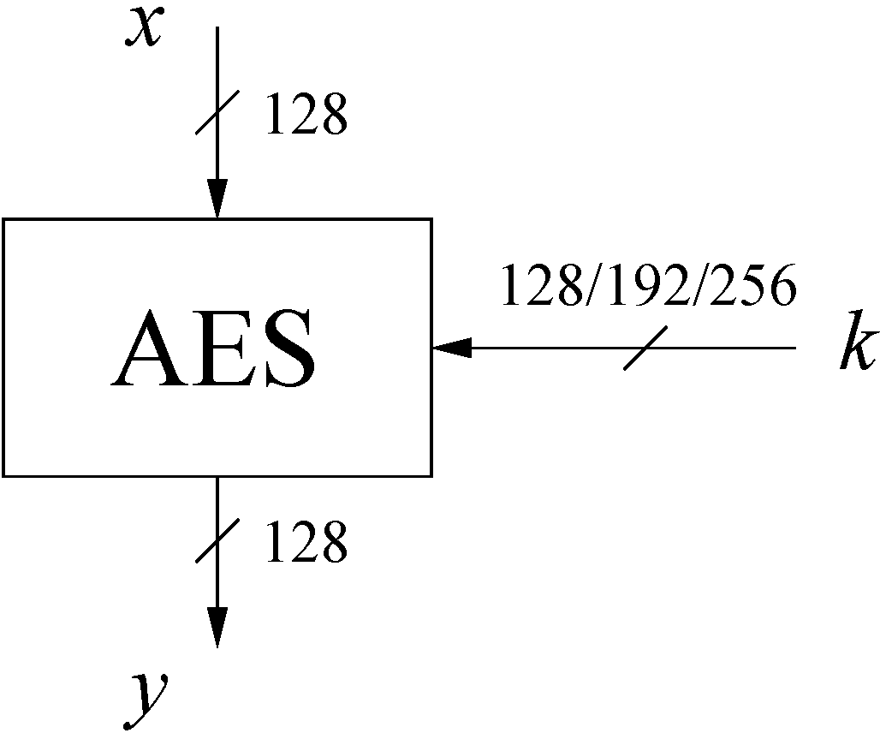
AES Overview
The number of rounds depends on the chosen key length:
 | Key length (bits) | Number of rounds
AES-128 | 128 | 10
AES-192 | 192 | 12
AES-256 | 256 | 14

Slide 7
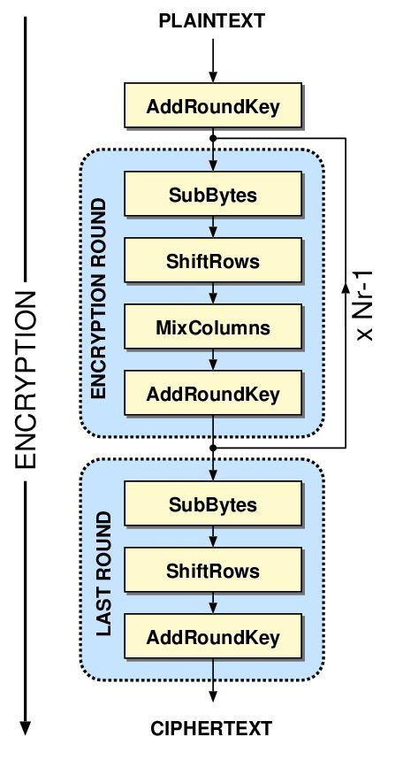
AES Overview
An iterative substitution-permutation network rather than Feistel cipher
Operates on entire data block in every round
10/12/14 rounds depending on the key size.
Each round consists of Confusion and Diffusion operations
Note: In the last round, the MixColumns transformation is omitted
🔑k₀
🔑k_{i}
🔑k_{Nr}
Notes:
Processes data as block of 4 columns of 4 bytes
Has 128/192/256 bit keys, 128 bit data
•It uses 10, 12, or 14 rounds. The key size, which can be 128, 192, or 256 bits, depends on the number of rounds.
Designed to have:
resistance against known attacks
speed and code compactness on many CPUs
design simplicity
State: Defines the current condition (state) of the block. That is the block of bytes that are currently being worked on.

Slide 8
Internal structure of AES

Slide 9
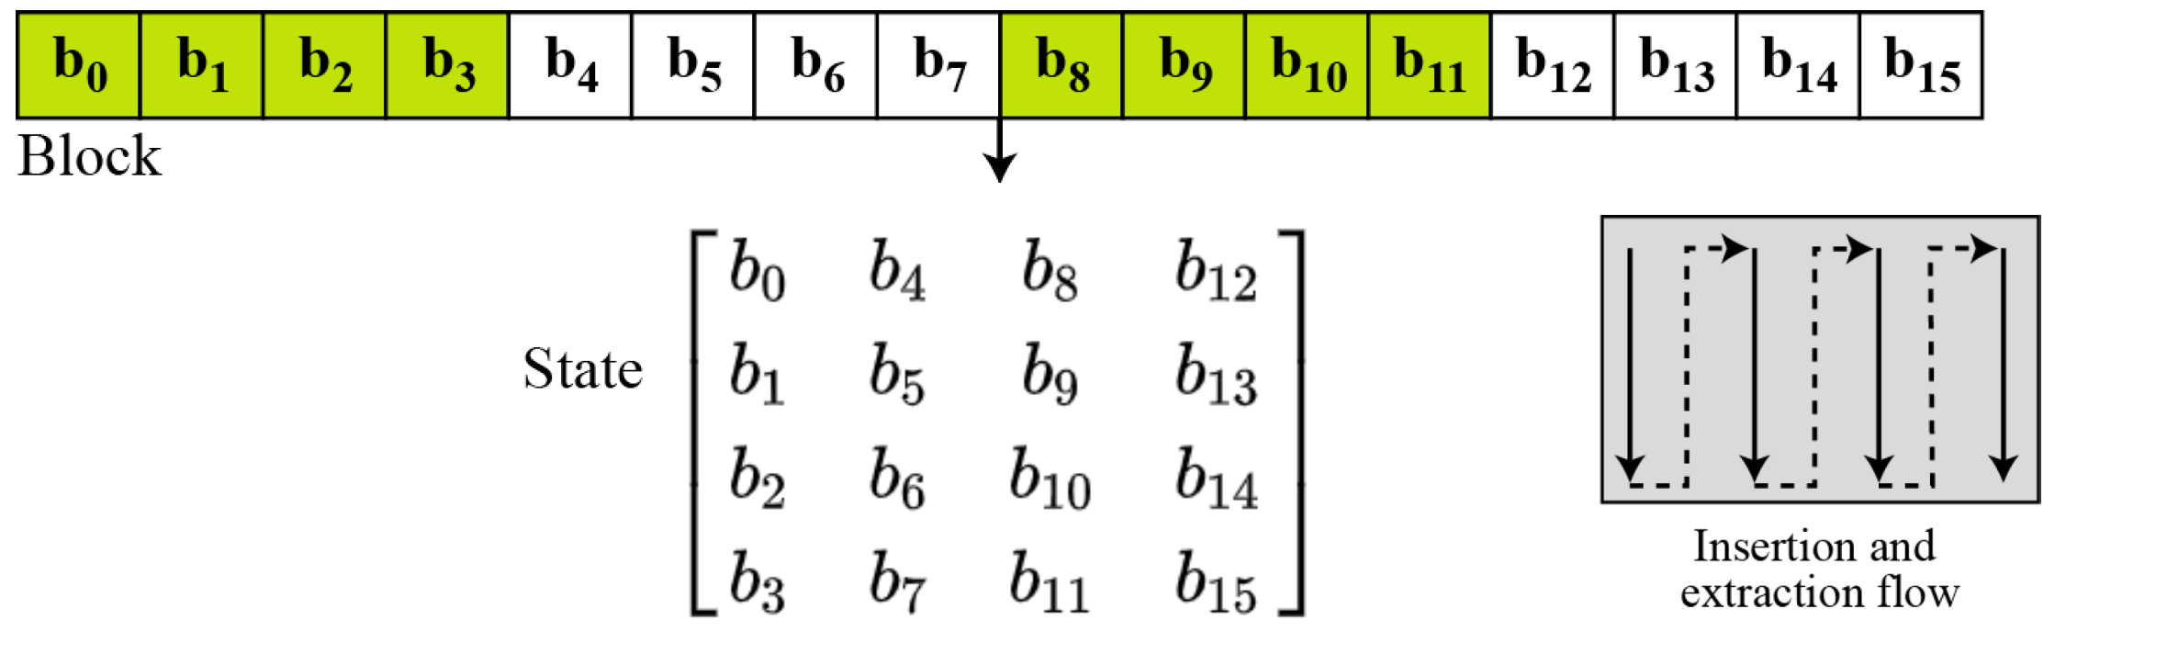
Block to state
AES is a byte-oriented cipher
State = Block of bytes that are currently being worked on
Arranged in 4 x 4 Matrix of bytes (b=Byte)
with b₀,…, b₁₅ denoting the 16-byte input of AES arranged in a 4x4 matrix
16 bytes * 8 bits/byte = 128bits (Block)

Slide 10
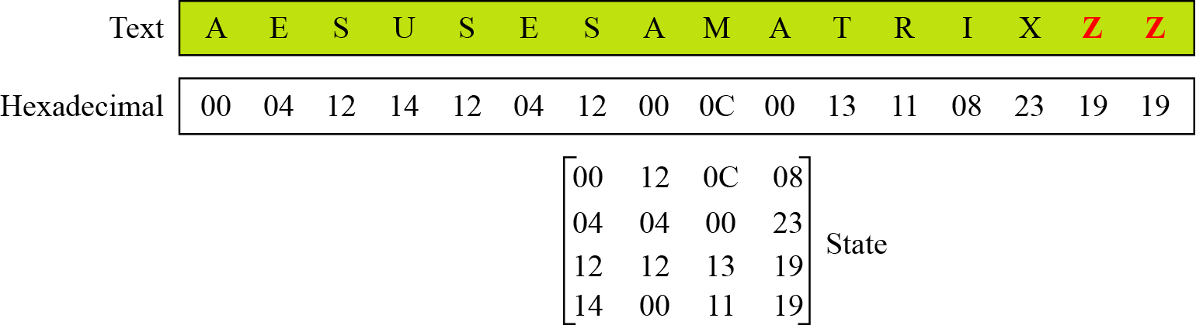
Block to state - example
 | A | B | C | D | E | F | G | H | I | J | K | L | M | N | O | P | Q | R | S | T | U | V | W | X | Y | Z
DEC | 0 | 1 | 2 | 3 | 4 | 5 | 6 | 7 | 8 | 9 | 10 | 11 | 12 | 13 | 14 | 15 | 16 | 17 | 18 | 19 | 20 | 21 | 22 | 23 | 24 | 25
HEX | 00 | 01 | 02 | 03 | 04 | 05 | 06 | 07 | 08 | 09 | 0A | 0B | 0C | 0D | 0E | 0F | 10 | 11 | 12 | 13 | 14 | 15 | 16 | 17 | 18 | 19

Slide 11

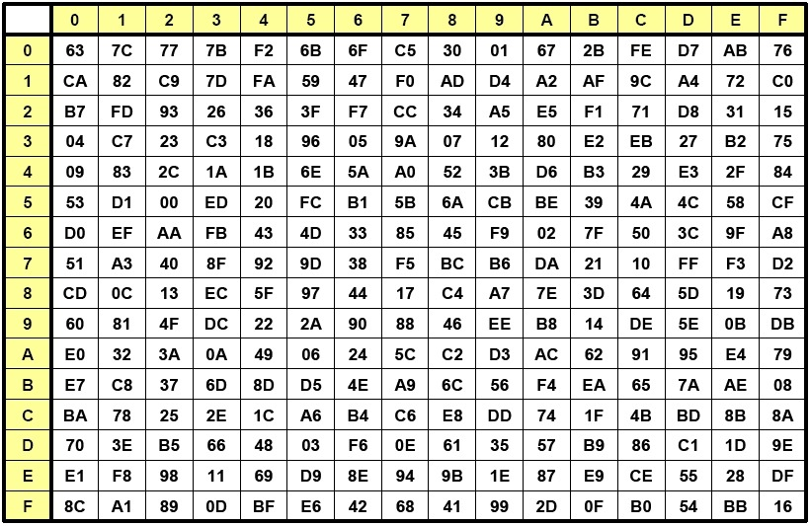
(1) SubBytes = Byte Substitution
Each value of the state is replaced with the corresponding S-Box value => bytewise S-Box substitution
E.g. HEX 14 would get replaced with HEX FA
Notes:
The Byte Substitution layer consists of
16 S-Boxes with the following properties:
The S-Boxes are
identical
the only nonlinear elements of AES, i.e., ByteSub(A_{i}) + ByteSub(A_{j}) ≠ ByteSub(A_{i} + A_{j}), for i,j = 0,…,15
bijective, i.e., there exists a one-to-one mapping of input and output bytes ⇒ S-Box can be uniquely reversed
In software implementations, the S-Box is usually realized as a lookup table

Slide 12
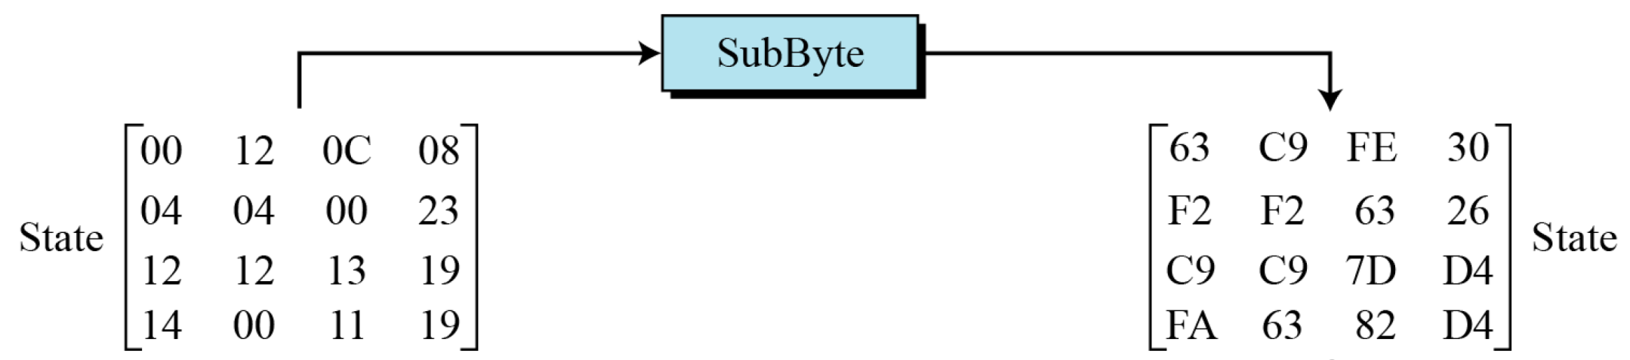
SubBytes Example
Notes:
During encryption

Slide 13
(2) Shift Rows
Performs Left Circular Shift of the state matrix row:
The circular shift just moves each byte one space over
Number of shifts depend on row #
B₀ | B₄ | B₈ | B₁₂
B₁ | B₅ | B₉ | B₁₃
B₂ | B₆ | B₁₀ | B₁₄
B₃ | B₇ | B₁₁ | B₁₅
Input matrix
B₀ | B₄ | B₈ | B₁₂
B₅ | B₉ | B₁₃ | B₁
B₁₀ | B₁₄ | B₂ | B₆
B₁₅ | B₃ | B₇ | B₁₁
no shift
← one position left shift
← two positions left shift
← three positions left shift
Output matrix
Notes:
Rationale = Transformation ensures that the 4 bytes of one column are spread out to four different columns
This is not a bit wise shift.
A byte that was in the second position may end up in the third position after the shift.
The circular part of it specifies that the byte in the last position shifted one space will end up in the first position in the same row.
The Diffusion layer consists of two sublayers:
ShiftRows Sublayer: Permutation of the data on a byte level
MixColumn Sublayer: Matrix operation which combines (“mixes”) blocks of four bytes

Slide 14
Shift Rows Example
63 | C9 | FE | 30
F2 | F2 | 63 | 26
C9 | C9 | 7D | D4
FA | 63 | 82 | D4
63 | C9 | FE | 30
F2 | 63 | 26 | F2
7D | D4 | C9 | C9
D4 | FA | 63 | 82
ShiftRows
Input State
Output State

Slide 15
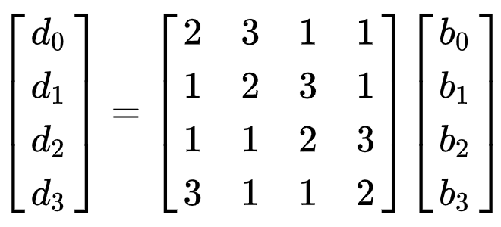
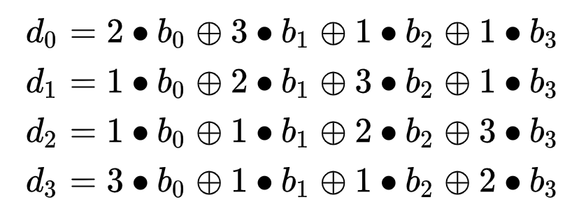
(3) MixColumns
The MixColumns transformation operates at the column level. It transforms each column of the state to a new column in the next state
Each 4-byte column is considered as a vector and multiplied by a fixed 4x4 matrix, e.g.,
Notes:
How to:
http://www.moserware.com/2009/09/stick-figure-guide-to-advanced.html
https://en.wikipedia.org/wiki/Rijndael_MixColumns
Galois field (https://en.wikipedia.org/wiki/Finite_field_arithmetic#Rijndael's_finite_field )
where 01, 02 and 03 are given in hexadecimal notation

Slide 16
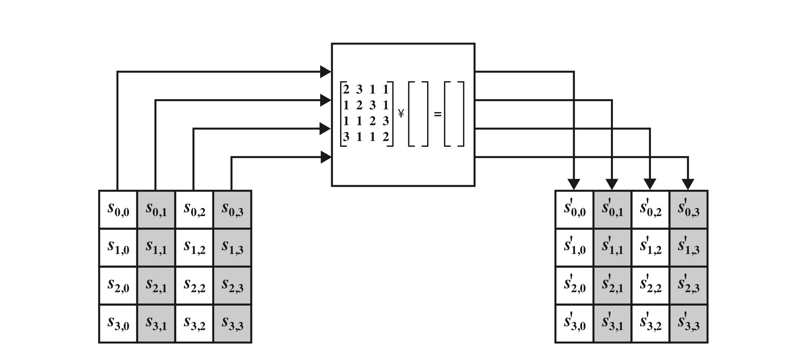
MixColumns Transformation
$$s_{0,0}^{′}=2∙s_{0,0}+3∙s_{1,0}+1{∙s}_{2,0}+1∙s_{3,0}$$
The MixColumns transformation operates at the column level. It transforms each column of the state to a new column.
Each 4-byte column is considered as a vector and multiplied by a fixed 4x4 matrix.
Notes:
Rationale = The mix column transformation combined with the shift row transformation ensures that after a few rounds all output bits depend on all input bits
AES Row and Column Operations

Slide 17
(4) Add Round Key
State matrix ⊕ Round key 🔑 matrix
Inputs:
16-byte state matrix C
16-byte subkey k_{i}
Output: C ⊕ k_{i}
The round keys are generated by the key schedule
Notes:
XOR state with 128-bits of the round key

Slide 18
AES Key Scheduling
Subkeys are derived recursively from the original 128/192/256-bit input key
Each round has 1 subkey, plus 1 subkey at the beginning of AES
Key whitening: Subkey is used both at the input and output of AES ⇒ # subkeys = # rounds + 1
There are different key schedules for the different key sizes
Key length (bits) | Number of Rounds | Number of subkeys
128 | 10 | 11
192 | 12 | 13
256 | 14 | 15
Notes:
Takes 128-bit (16-byte) key and expands into array of 32-bit words
Start by copying key into first 4 words
Then loop creating words that depend on values in previous & 4 places back
in 3 of 4 cases just XOR these together
1st word in 4 has rotate + S-box + XOR round constant on previous, before XOR 4th back

Slide 19
AES Key Scheduling
🔑k₀
🔑k_{i}
🔑k_{Nr}
Notes:
Processes data as block of 4 columns of 4 bytes
Has 128/192/256 bit keys, 128 bit data
•It uses 10, 12, or 14 rounds. The key size, which can be 128, 192, or 256 bits, depends on the number of rounds.
Designed to have:
resistance against known attacks
speed and code compactness on many CPUs
design simplicity
State: Defines the current condition (state) of the block. That is the block of bytes that are currently being worked on.

Slide 20
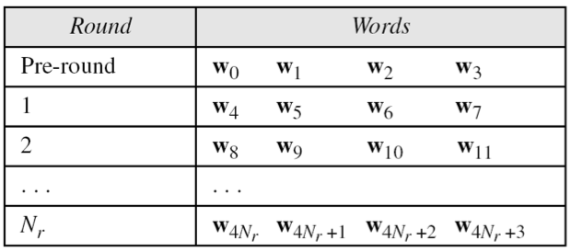
AES Key Scheduling
Takes 128-bits (16-bytes) key and expands into array of 44 32-bit words
11 subkeys are stored in W[0]…W[3], W[4]…W[7], … , W[40]…W[43]
K₀
K₁
K₂
K_{Nr}
Notes:
The AES key expansion algorithm takes as input a 4-word (16-byte) key and produces a linear array of words, providing a 4-word round key for the initial AddRoundKey stage and each of the 10/12/14 rounds of the cipher. It involves copying the key into the first group of 4 words, and then constructing subsequent groups of 4 based on the values of the previous & 4th back words. The first word in each group of 4 gets “special treatment” with rotate + S-box + XOR constant on the previous word before XOR’ing the one from 4 back. In the 256-bit key/14 round version, there’s also an extra step on the middle word.
Word-oriented: 1 word = 32 bits
11 subkeys are stored in W[0]…W[3], W[4]…W[7], … , W[40]…W[43]
First subkey W[0]…W[3] is the original AES key

Slide 21
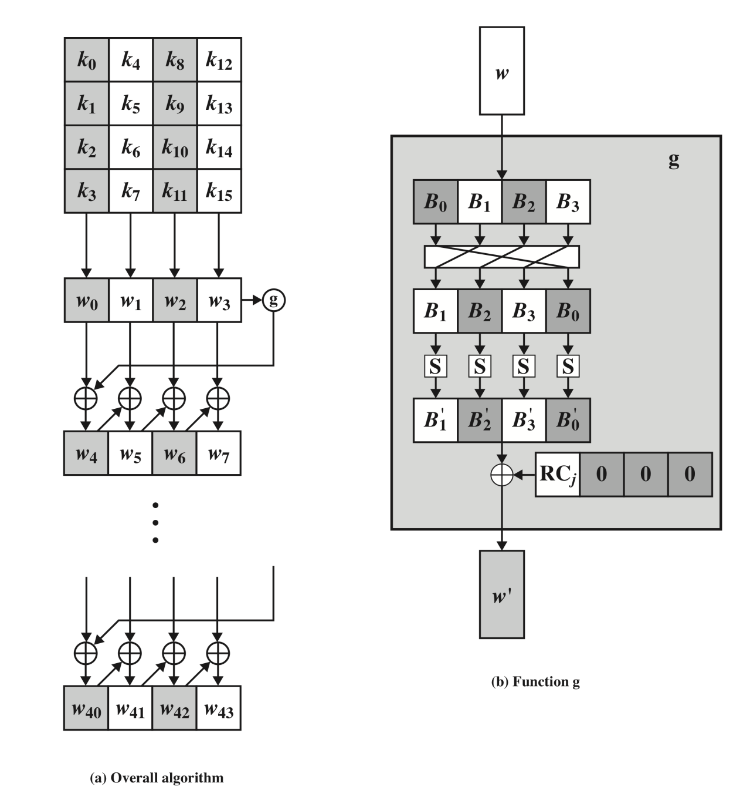
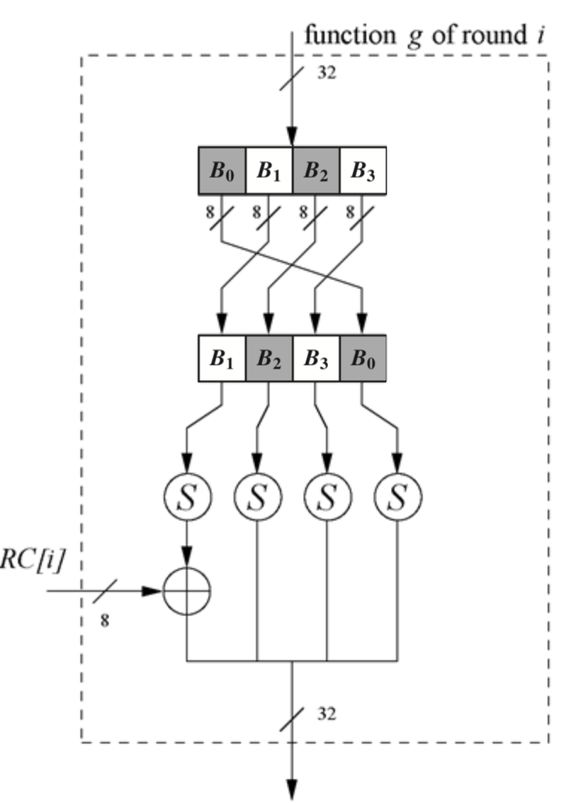
AES Key Expansion
First subkey(K₀) W[0]…W[3] is the original AES key
Constructing subsequent groups of 4 words based on the Previous Word (W_{i-1}) & 4th back Word (W_{i-4})
W_{i} = W_{i-1} ⊕ W_{i-4}
For all values of i that are not multiples of 4.
1st word in each group gets a “special treatment” using function g before XOR’ing the 4th back Word (W_{i-4})
W_{i} = g(W_{i-1} ) ⊕ W_{i-4}
Rotate
S-box
XOR
Rotate -> S-box -> XOR a constant

Slide 22

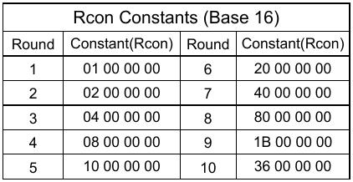
Key Expansion - 1st Word “special treatment”
Function g rotates its four input bytes and performs a bytewise S-Box substitution
Leftmost byte is XORed with a Round Constant (RC):
Notes:
RotWord performs a one byte circular left shift on a word For example:
RotWord[b0,b1,b2,b3] = [b1,b2,b3,b0]
SubWord performs a byte substitution on each byte of input word using the S-box
SubWord(RotWord(temp)) is XORed with RCon[j] – the round constant
Key used for encryption is of 128 bits arranged as four words
⇒ nonlinearity
x^{i} represents an element in a Galois field (again, cf. Chapter 4.3 of Understanding Cryptography)
The round coefficient RC is only added to
the

Slide 23
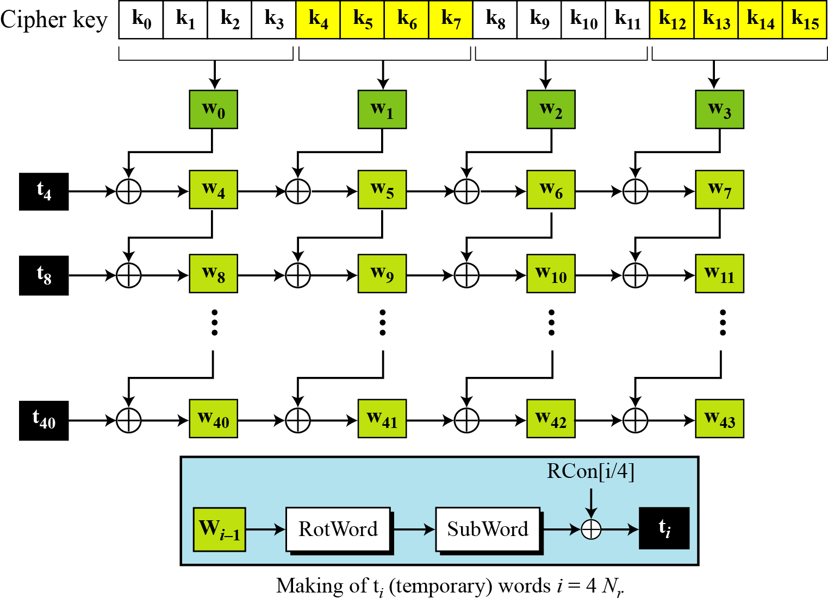
Key Expansion Scheme – Another View
RC[i]
g(i) =

Slide 24
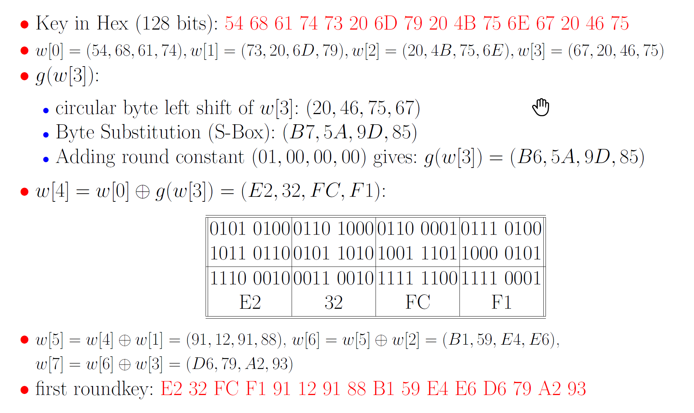
Example - First Roundkey

Slide 25
AES S-Box
Notes:
The Byte Substitution layer consists of
16 S-Boxes with the following properties:
The S-Boxes are
identical
the only nonlinear elements of AES, i.e., ByteSub(A_{i}) + ByteSub(A_{j}) ≠ ByteSub(A_{i} + A_{j}), for i,j = 0,…,15
bijective, i.e., there exists a one-to-one mapping of input and output bytes ⇒ S-Box can be uniquely reversed
In software implementations, the S-Box is usually realized as a lookup table

Slide 26
Decryption

Slide 27
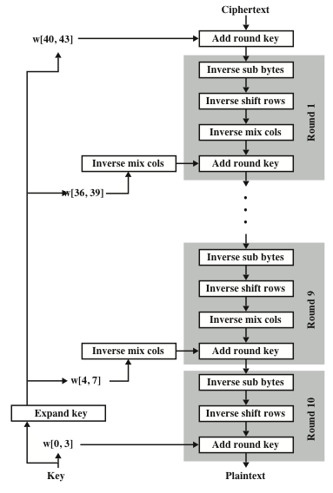
Decryption
AES is not based on a Feistel network
⇒ AES decryption is not identical to encryption. But each step must be inverted for decryption:
ShiftRows → Inv ShiftRows
MixColumn → Inv MixColumn
Byte Substitution → Inv Byte Substitution
Key Addition uses XOR
Subkeys are needed in reversed order

Slide 28
Inv ShiftRows
All rows of the state matrix B are shifted to the opposite direction:
Input matrix
Output matrix
B₀ | B₄ | B₈ | B₁₂
B₁ | B₅ | B₉ | B₁₃
B₂ | B₆ | B₁₀ | B₁₄
B₃ | B₇ | B₁₁ | B₁₅
B₀ | B₄ | B₈ | B₁₂
B₁₃ | B₁ | B₅ | B₉
B₁₀ | B₁₄ | B₂ | B₆
B₇ | B₁₁ | B₁₅ | B₃
no shift
→ one position right shift
→ two positions right shift
→ three positions right shift
Notes:
Inv Byte Substitution layer:
Since the S-Box is bijective, it is possible to construct an inverse, such that
A_{i} = S⁻¹(B_{i}) = S⁻¹(S(A_{i}))
⇒ The inverse S-Box is used for decryption. It is usually realized as a lookup table
Implementation:
One requirement of AES was the possibility of an efficient software implementation
Straightforward implementation is well suited for 8-bit processors (e.g., smart cards), but inefficient on 32-bit or 64-bit processors
A more sophisticated approach: Merge all round functions (except the key addition) into one table look-up
This results in four tables with 256 entries, where each entry is 32 bits wide
One round can be computed with 16 table look-ups
Typical SW speeds are more than 1.6 Gbit/s on modern 64-bit processors

Slide 29
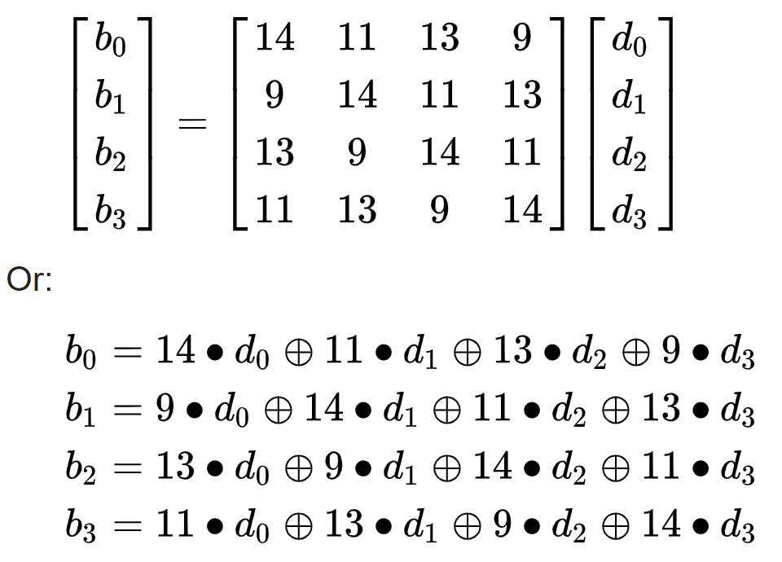
Inv MixColumn
The MixColumns operation has the following inverse (numbers are decimal):
https://en.wikipedia.org/wiki/Rijndael_MixColumns
Notes:
https://en.wikipedia.org/wiki/Rijndael_MixColumns
Again, all arithmetic is done in the Galois field GF(2⁸) (for more information see Chapter 4.3 in Understanding Cryptography)
To reverse the MixColumn operation, each column of the state matrix C must be multiplied with the inverse of the 4x4 matrix, e.g.,
To reverse the MixColumn operation, each column of the state matrix C must be multiplied with the inverse of the 4x4 matrix, e.g.,
where 09, 0B, 0D and 0E are given in hexadecimal notation

Slide 30
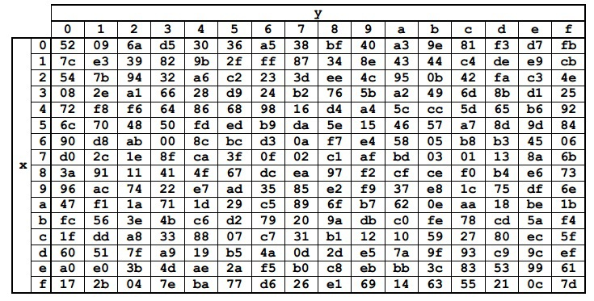
InvSubByte
During decryption each value in the state is replaced with the corresponding inverse of the S-Box
For example HEX D4 would get replaced with HEX 19
Notes:
Inv MixColumn layer:
To reverse the MixColumn operation, each column of the state matrix C must be multiplied with the inverse of the 4x4 matrix, e.g.,
where 09, 0B, 0D and 0E are given in hexadecimal notation

Slide 31
AES Security
Brute-force attack: Due to the key length of 128, 192 or 256 bits, a brute-force attack is not possible
Analytical attacks: There is no known analytical attack.
Side-channel attacks:
Several side-channel attacks have been published
Note that side-channel attacks do not attack the underlying algorithm but its implementation

Slide 32
Summary
AES is a modern block cipher which supports three key lengths of 128, 192 and 256 bit. It provides excellent long-term security against brute-force attacks.
AES has been studied intensively since the late 1990s and no attacks have been found.
AES is not based on Feistel networks. It is an iterative cipher. Each round = 4 steps of SubBytes, ShiftRows, MixColumns, and AddRoundKey (last round no MixColumns)
Decryption is not the same as encryption (as in DES). Decryption consists of inverse steps.
AES is efficient in software and hardware.
It seems likely that the cipher will be the dominant encryption algorithm for many years to come.
Notes:
1.
AES encrypts 128 bit blocks with 128
128-bit, 192 192-bit or 256 256-bit
keys using 10, 12, or 14 rounds, respectively.
2.
Is not a
Feistel cipher All 128 bits are encrypted
3.
Each round = 4 steps of
SubBytes SubBytes, ShiftRows ShiftRows, MixColumns MixColumns,
and AddRoundKey AddRoundKey.
4.
Last round has only 3 steps. No
MixColumns MixColumns.
5.
Decryption is not the same as encryption (as in DES).
Decryption consists of inverse steps.
AES is part of numerous open standards such as IPsec or TLS, in addition to being the mandatory encryption algorithm for US government applications.

Slide 33
Resources
Crypto Tool 2
https://www.cryptool.org/en/cryptool2
AES Wikipedia page
https://en.wikipedia.org/wiki/Advanced_Encryption_Standard
Notes:
AES Animation http://www.formaestudio.com/rijndaelinspector/archivos/rijndaelanimation.html

Slide 34
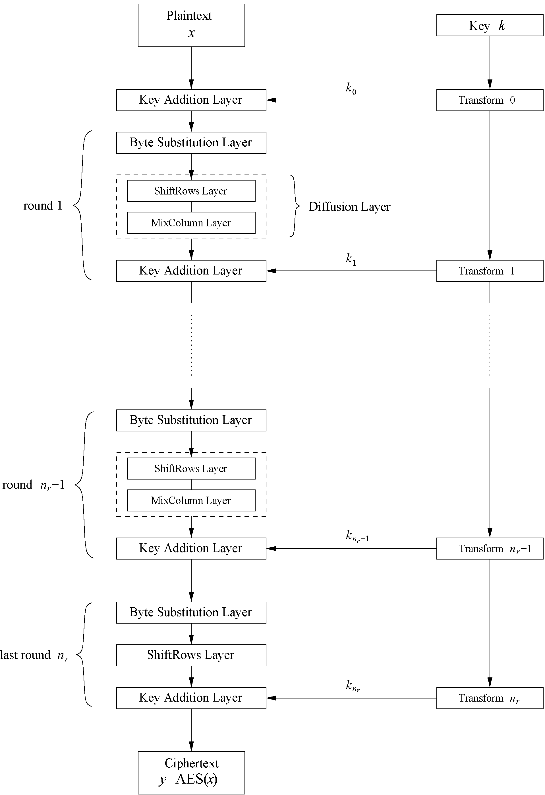
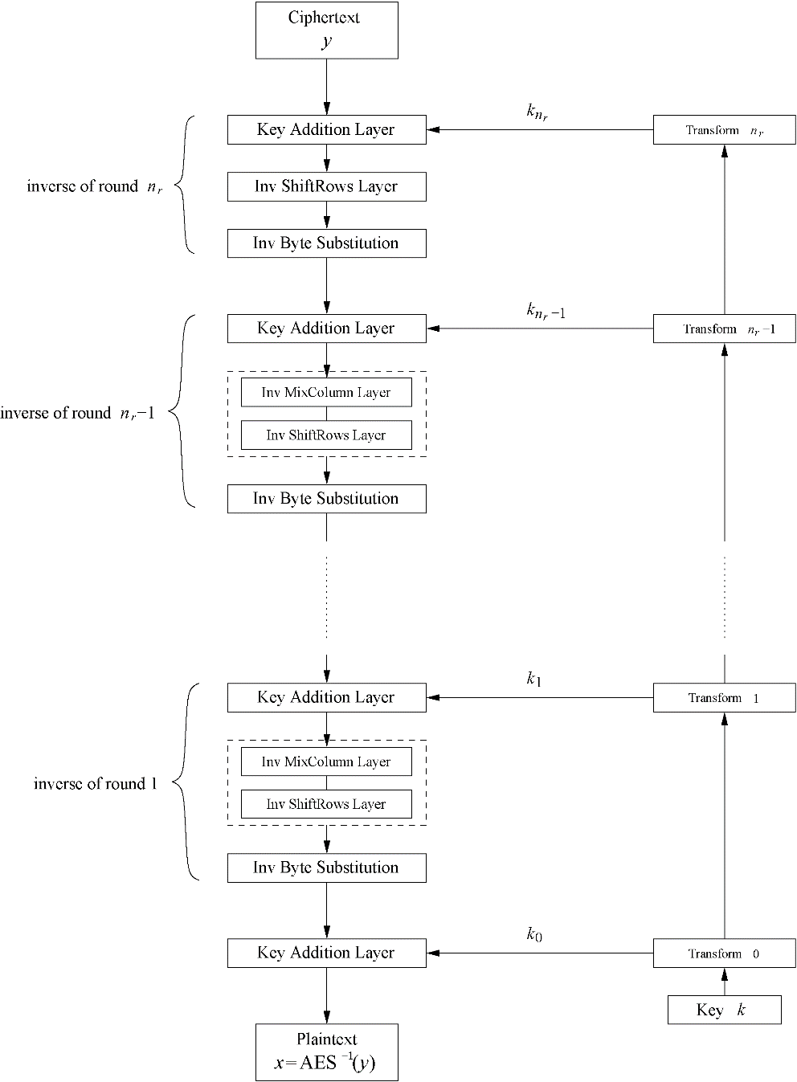

Slide 35
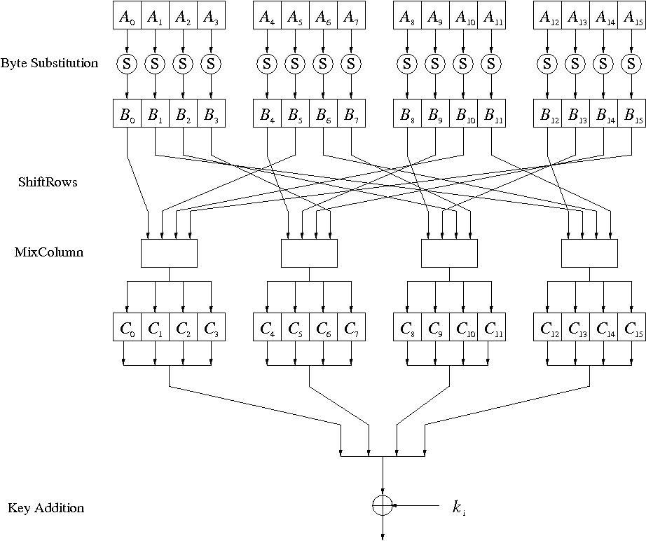
Internal Structure of AES
Round function for rounds 1,2,…,n_{r-1}:

Slide 36
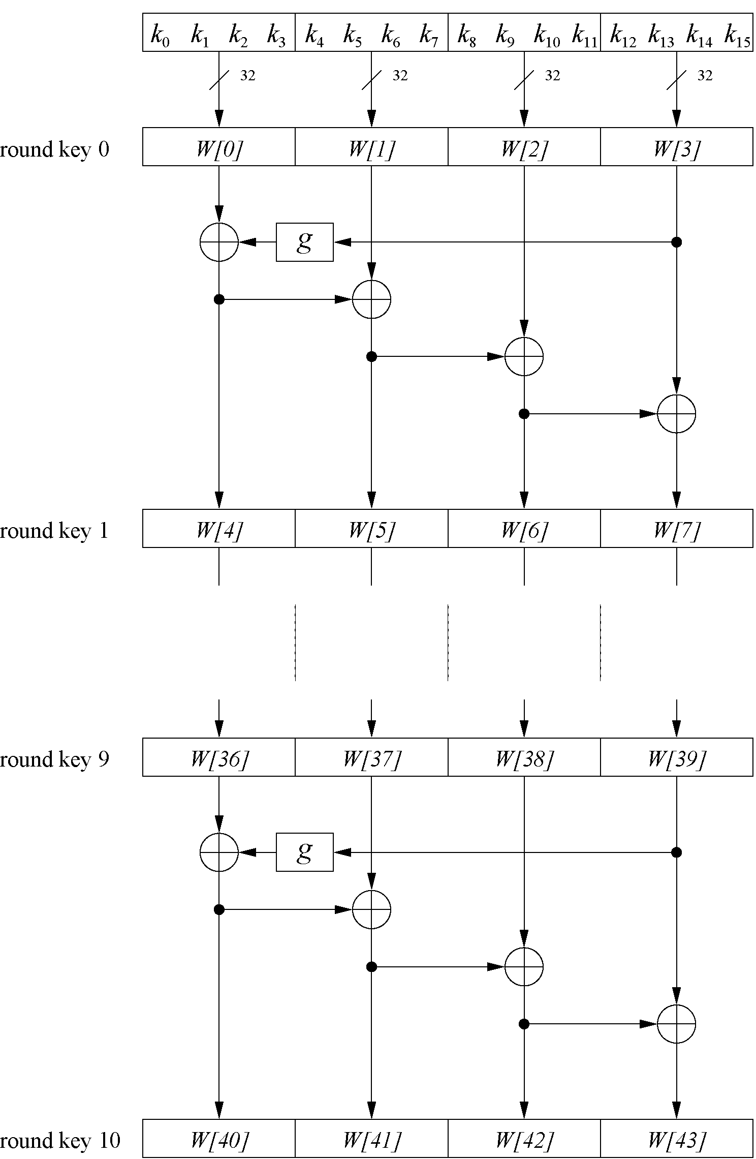
Key Schedule
Example: Key schedule for 128-bit key AES
Word-oriented: 1 word = 32 bits
11 subkeys are stored in W[0]…W[3], W[4]…W[7], … , W[40]…W[43]
First subkey W[0]…W[3] is the original AES key

